Slide 1




NEXT GEN EMPLOYABILITY PROGRAM
Creating a future-ready workforce
Team Members
College Name
Student Name :
Student ID : au814721104006
Archana Ashokkumar
SRM TRP Engineering College

Slide 2

CAPSTONE PROJECT SHOWCASE
Project Title
Notes Sharing Web Application using Django Framework
Abstract | Problem Statement | Project Overview | Proposed Solution | Technology Used | Modelling & Results | Conclusion

Slide 3
Abstract My project focuses on developing a Notes Sharing Web Application utilizing the Django framework. It offers users a platform to create, manage, and share notes securely. Key features include user authentication, note creation/editing, sharing capabilities, access control, search/filtering options, and responsive design. By leveraging Django's robust features, the application promotes collaboration, productivity, and efficient knowledge sharing. project presents the creation of a Notes Sharing Web Application using Django, a Python web framework known for its simplicity and scalability. The application allows users to register, log in securely, and manage their profiles. Users can create, edit, categorize, and share notes with others, fostering collaboration and knowledge exchange. With advanced features like access control, search, and responsive design, our platform aims to streamline the note-taking process and enhance productivity. By leveraging Django's capabilities, we ensure a robust, secure, and user-friendly experience for individuals seeking efficient note management and sharing solutions.

Slide 4
Problem Statement In an era where collaboration and knowledge exchange are essential, existing note-taking applications often lack robust features for secure sharing and efficient management. Users face challenges in organizing and accessing their notes across various platforms. Thus, there is a need for a centralized Notes Sharing Web Application built on Django, offering secure sharing, access control, and seamless collaboration to streamline the note-taking process and enhance productivity.

Slide 5
Project Overview The Notes Sharing Web Application is designed to provide users with a centralized platform for creating, managing, and sharing notes efficiently. Leveraging the Django framework, the application ensures robustness, scalability, and security. Key features include user authentication, note creation and organization, secure sharing, access control, advanced search, and responsive design. The application aims to streamline the note-taking process, enhance productivity, and facilitate collaborative learning and knowledge sharing.

Slide 6
Proposed Solution Our proposed solution is a Django-based Notes Sharing Web Application that provides users with a secure and user-friendly platform for creating, managing, and sharing notes. Key features include user authentication, note creation and organization, secure sharing with access control, advanced search capabilities, and responsive design. By integrating these features, our solution aims to address the complexities associated with note management and collaboration, providing users with a robust platform to streamline their workflow, boost productivity, and foster collaborative learning and knowledge sharing.
.

Slide 7


Technology Used
Front-end
Back-end

Slide 8
Modelling & Results Database Schema Design: We've structured a relational database using Django's ORM for efficient data storage and retrieval. User Interface Design: Employing modern frontend technologies like HTML5, CSS3, and Bootstrap, we've crafted an intuitive and visually appealing interface. Feature Implementation: Key functionalities such as user authentication, note management, sharing, access control, and search have been implemented using Django's capabilities and third-party libraries. Testing and Quality Assurance: Rigorous testing, including unit tests, integration tests, and user acceptance tests, ensures reliability and security. Continuous integration and deployment pipelines automate testing and deployment processes. User Feedback and Iterative Development: Continuous feedback from users drives iterative improvements, enhancing features, usability, and performance. Performance Optimization: Monitoring performance metrics enables optimization techniques such as caching, indexing, and code optimization for scalability and efficiency. In summary, our approach ensures a robust, user-friendly, and feature-rich Notes Sharing Web Application, validated through thorough testing and iterative development.

Slide 9
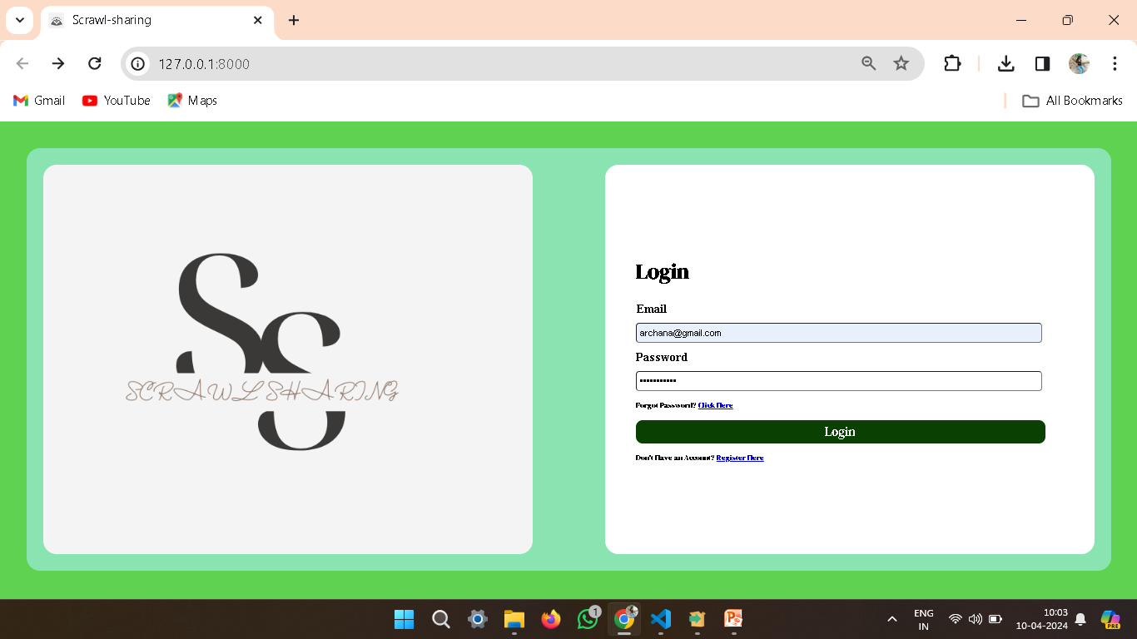
Homepage

Slide 10
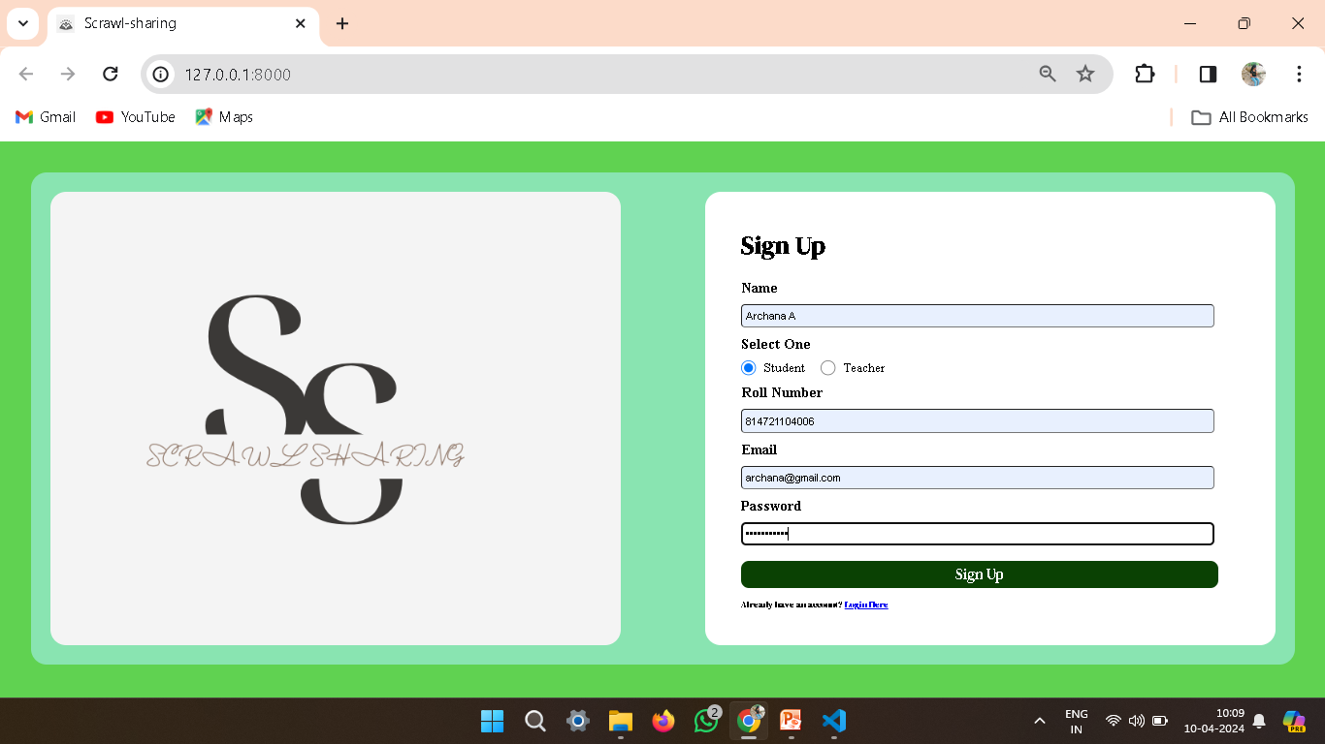
Student’s Login

Slide 11
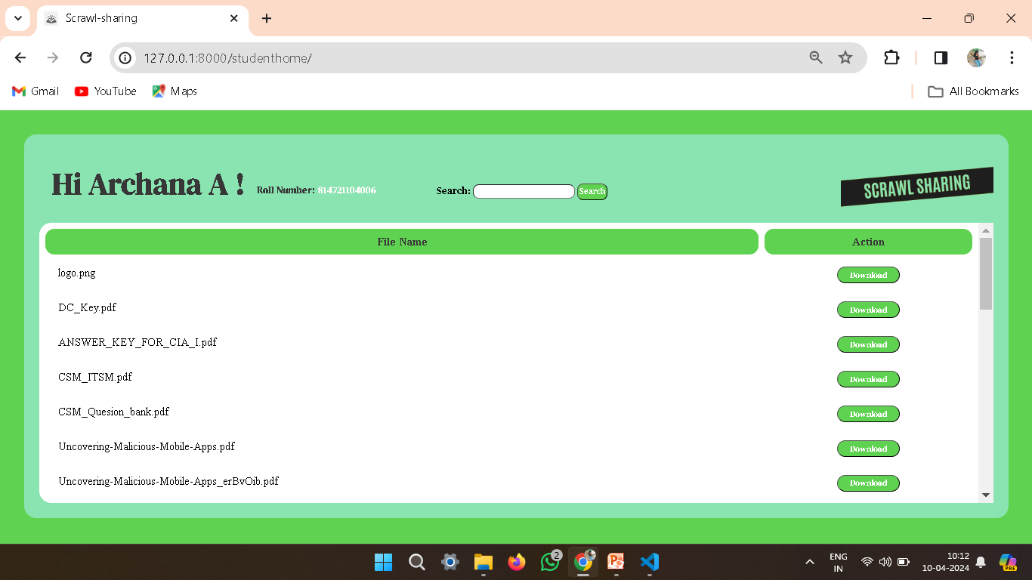
Student’s page

Slide 12

Teacher’s login

Slide 13
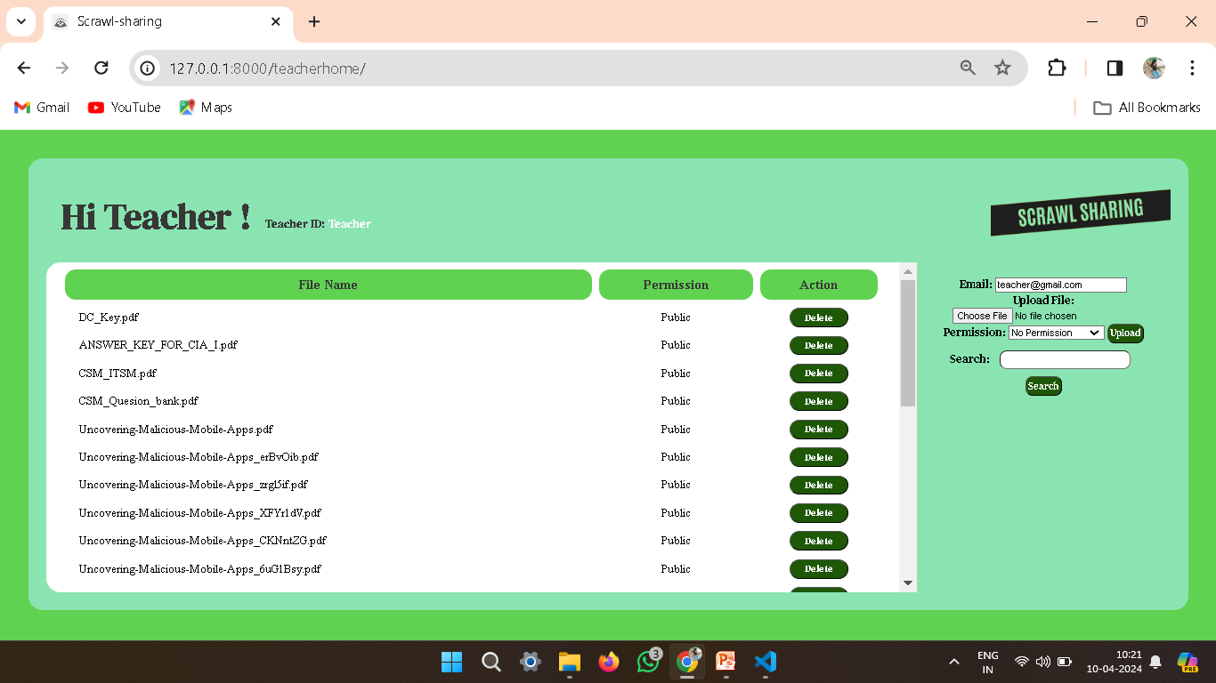
Teacher’s page

Slide 14
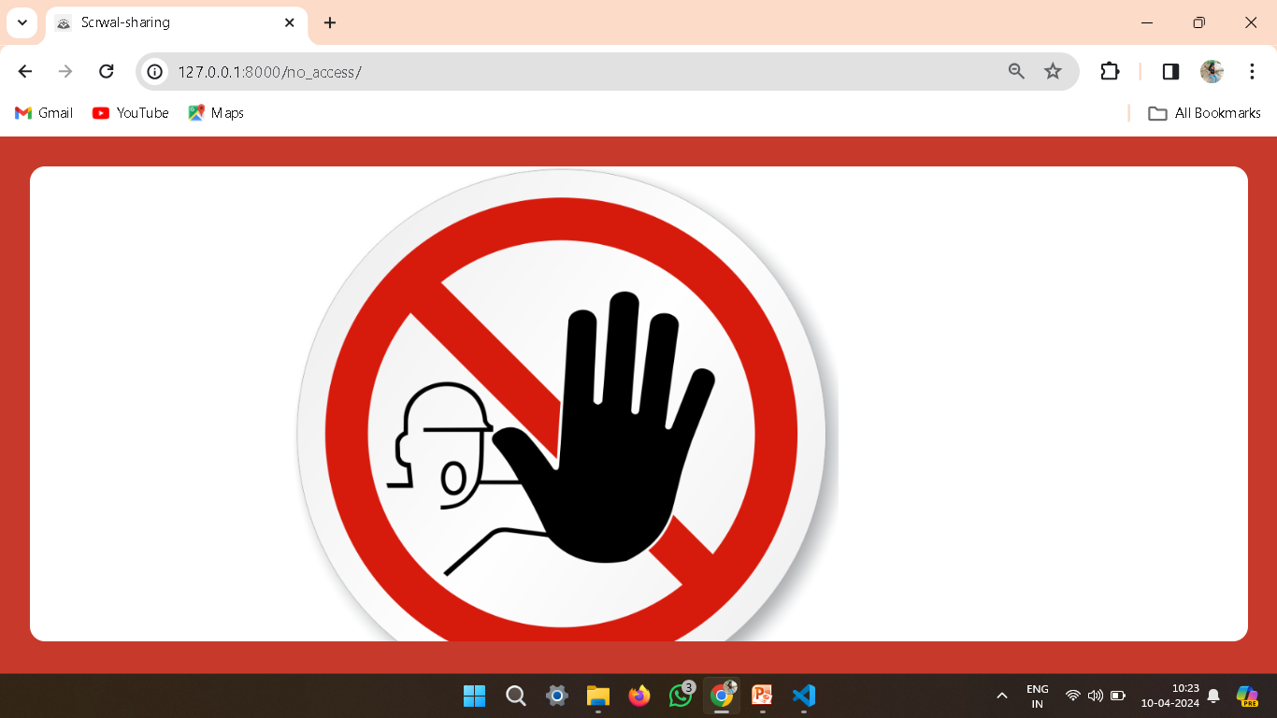
No Access

Slide 15
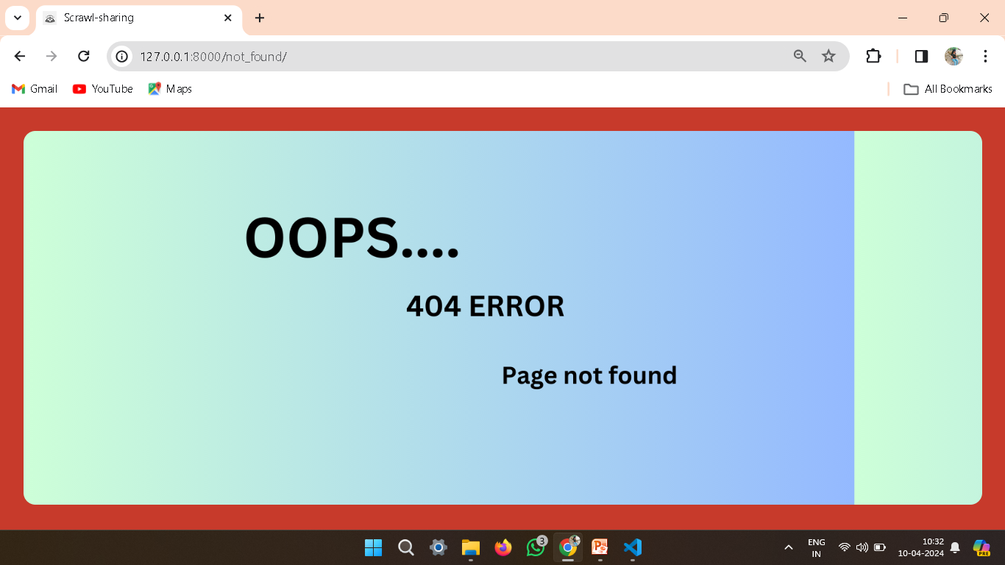
404 error

Slide 16
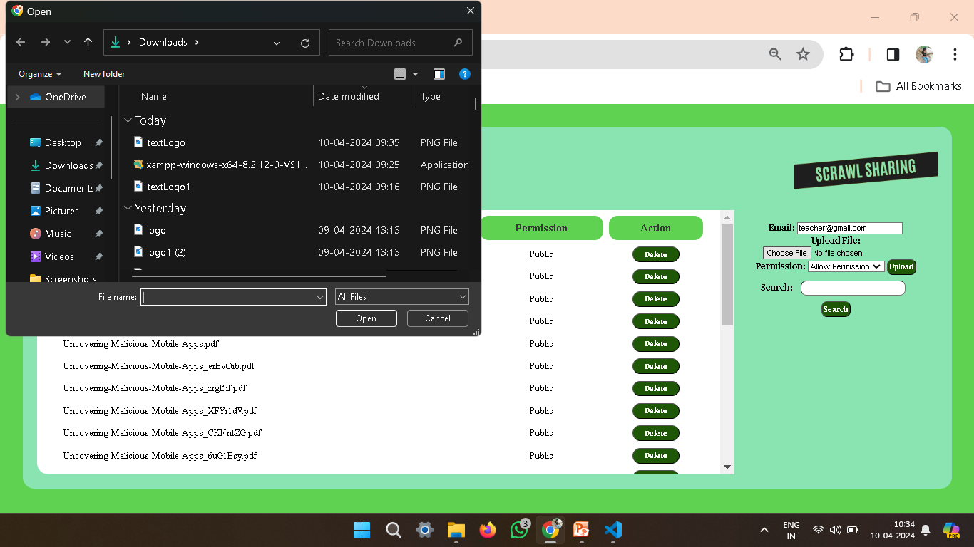
Teacher’s upload page(Allow a permission)

Slide 17
Future Enhancements:
In future iterations, our Notes Sharing Web Application will see enhancements across various fronts to elevate user experience and functionality. Real-time collaboration features will be introduced, allowing users to engage in synchronous editing and commenting, fostering seamless teamwork. Offline access capabilities will enable users to edit notes even when disconnected, with automatic synchronization upon reconnection. Integration with popular cloud storage services like Google Drive and Dropbox will provide users with seamless import and export options, enhancing flexibility and accessibility. Additionally, machine learning algorithms will analyze note content to offer personalized suggestions, optimizing the note-taking process. Native mobile applications for iOS and Android platforms will ensure a consistent user experience across devices, while enhanced security measures such as end-to-end encryption and two-factor authentication will safeguard user data. Integration with productivity tools, customizable templates, analytics insights, and accessibility improvements will further enrich the application's functionality, catering to diverse user needs and preferences.

Slide 18
Conclusion
In conclusion, our Notes Sharing Web Application built on the Django framework offers a robust platform for efficient note management and collaboration. Through the implementation of key features such as user authentication, note creation and organization, secure sharing, and advanced search capabilities, we have provided users with a user-friendly and intuitive tool to streamline their note-taking process. Looking ahead, future enhancements including real-time collaboration, offline access, cloud storage integration, and machine learning suggestions promise to further elevate the application's functionality and user experience. With a focus on continuous improvement and responsiveness to user feedback, we are committed to ensuring that our platform remains a valuable tool for individuals and teams seeking to enhance productivity and facilitate knowledge sharing.

Slide 19
Thank You!
Notes:
Thank You !!

